Slide 1
Avatar-Based
AI
Mock Interview System

Slide 2



Bhubaneswar Engineering college
DEPARTMENT OF COMPUTER SCIENCE AND ENGINEERING
Submitted By
BISHNU CHARAN NAYAK | 2321316046
CHINMAYA PRADHAN | 2201316010
OMM SHUBAM SAHOO | 2201316020
Under the guidance of
Mrs. ANITA BEHERA, B Tech
Assistant Professor (hod)

Slide 3
CONTENTS
 Introduction
 Abstract
 Problem Statement
 Existing System
 Proposed System
 Modules
 Frontend
 Backend
 System Requirements
 UML diagrams
 Output
 Conclusion
 References

Slide 4
Introduction
4
Purpose: The project aims to revolutionize interview preparation by offering an immersive and personalized mock interview experience.
Problem: Traditional interview preparation tools lack adaptability, contextual understanding, and
realism making them less effective for candidates.
Solution: The AI Mock Interview Tool leverages LLMs, 3D avatars, and speech recognition to generate context-aware questions and provide real-time feedback, creating a lifelike and effective preparation environment.

Slide 5
Abstract
5
The AI Mock Interview Tool offers a realistic interview experience through a 3D avatar powered
by advanced AI-driven contextual questioning.
Integrated speech recognition and natural language processing provide personalized feedback,
helping candidates enhance their communication skills and performance.
A customizable role-based structure allows users to select scenarios, adjust difficulty levels, and
track progress seamlessly.

Slide 6
Problem Statement
Interview preparation is often hindered by a lack of realistic and personalized practice opportunities.
Traditional mock interviews are time-consuming, costly, and don't provide scalable or consistent feedback.
Candidates face difficulties in assessing their performance and identifying areas for improvement effectively.
There is a gap in providing personalized feedback to help candidates identify and improve their weaknesses effectively.

Slide 7
Existing System
EZ Interviewer: AI-based mock interview generator using BERT and Transformers to create personalized, resume/job description-based dialogs, designed to enhance job interview preparation in low-resource environments.
Talking Avatar in VR: Immersive training system leveraging Unity, Oculus Quest 2, and Rasa to simulate investigative interviews with realistic child avatars for CPS professionals.
Advanced Conversational AI: Both systems utilize state-of-the-art NLP techniques like IBM Watson TTS/STT and pre-trained models to deliver dynamic, context-aware interactions.
Cost-Effective Training Tools: Provide scalable, innovative solutions to traditional training methods, improving user engagement and real-world applicability.

Slide 8
Proposed System
6
3D Avatar: We will use a 3D avatar with animations to create a realistic interviewer who will respond naturally, simulating a real interview environment.
Web Application: The system will be a web app built with React and Three.js, making it cost-effective and
accessible on any device, without the need for VR technology.
Langchain Memory: Langchain memory will allow the system to track the conversation and ask follow-up questions based on previous answers, making the interview feel more natural.
Error Management: If there’s any misunderstanding or inappropriate response, the system will end the
interview respectfully and inform the user.
Interview Evaluation: After the interview, the system will evaluate responses, tone, and confidence, providing a scorecard with feedback on strengths and areas for improvement.

Slide 9
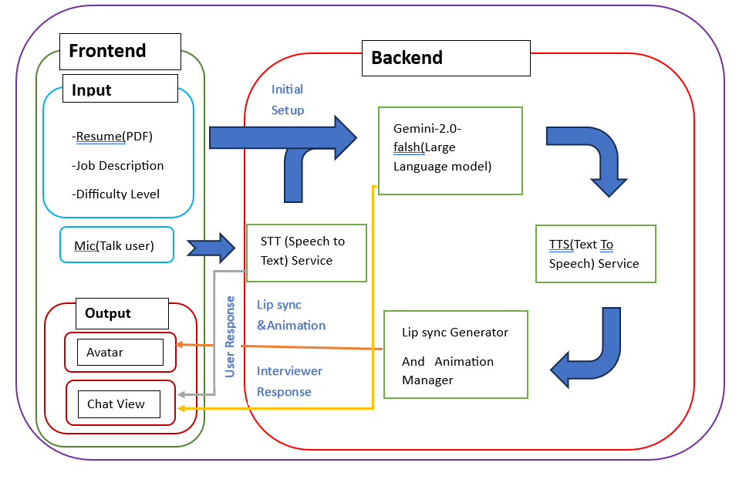
System Architecture
7
Fig. 1: System Architecture

Slide 10
Frontend
8
 Overview:
The frontend is responsible for user interaction, handling input, and displaying AI-driven interview responses.
 Key Components:
Input Section:
Resume (PDF), Job Description, Difficulty Level – Users upload these to personalize the interview.
Microphone (Google Web Speech API) – Captures user responses in real time.
Processing Section:
Sends user input to the backend for AI processing.
Displays real-time responses from the AI interviewer.
Output Section:
Ready Player Me Avatar – A realistic 3D avatar acts as the AI interviewer.
Chat View – Displays conversation history for user verification.

Slide 11
Backend
9
 Overview:
The backend processes user responses using AI, speech recognition, and animation techniques.
 Key Components:
Speech-to-Text (STT) Service: Uses Google Web Speech API to convert user speech into text.
Large Language Model (LLM): Uses Llama 3-70B Versatile to generate dynamic interview questions and evaluate responses.
Text-to-Speech (TTS) Service: Uses Edge TTS to convert AI-generated text into realistic speech.
Lip Sync & Animation Manager:
Rhubarb – Generates accurate lip-sync for the avatar.
Adobe Mixamo – Provides realistic avatar animations.
3D Avatar (Ready Player Me): Represents the AI interviewer, making the experience immersive.

Slide 12
System Requirements
10
 Hardware Requirements
Processor: Intel i5 or higher / AMD Ryzen 5 or higher
RAM: Minimum 8 GB (16 GB recommended for smooth operation)
Storage: At least 20 GB of free disk space
Camera: webcam for facial analysis (optional)
Microphone: Integrated or external for voice input
 Software Requirements
Operating System: Windows 10pro or higher, macOS, or Linux
Programming Environment: Python 3.11.15 or Higher
Browser: Chrome, Firefox, or Edge (for web-based tools)
 Network Requirements
Stable internet connection (minimum 10 Mbps) for accessing cloud models, updates, or external APIs.

Slide 13
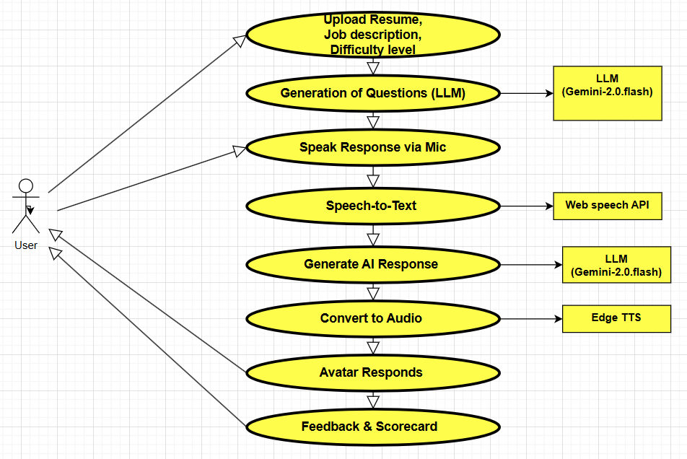
UML Diagrams
11
 Use case Diagram
Fig. 2: Use Case diagram

Slide 14
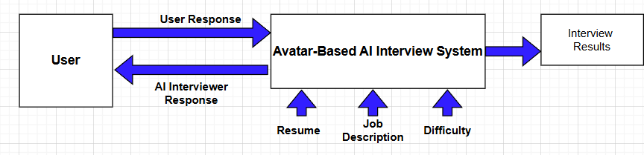
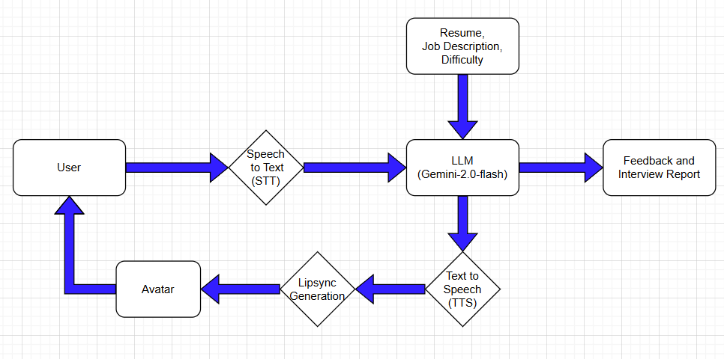
UML Diagrams
12
 Data Flow Diagram (Context Level)
Fig. 3: Data Flow Diagram Level-1
 Data Flow Diagram (DFD detailed)
Fig. 4: Data Flow Diagram Level-2

Slide 15
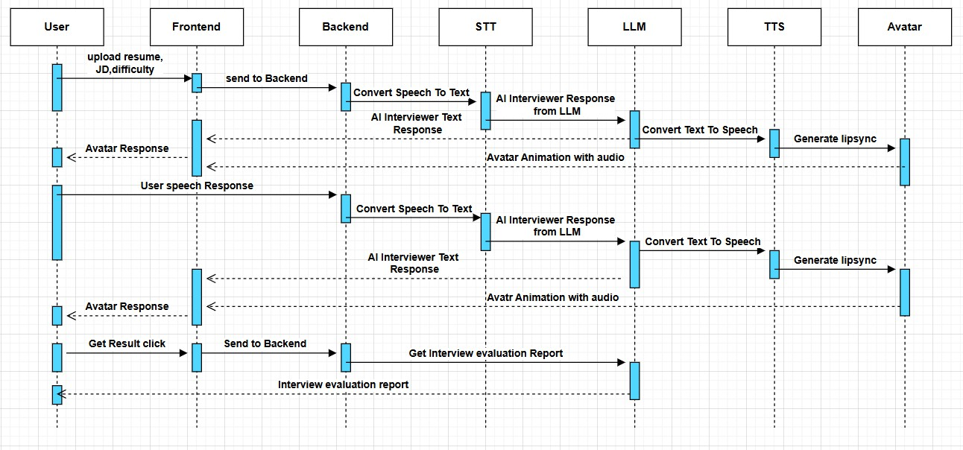
UML Diagrams
13
 Sequence Diagram
Fig. 5: Sequence Diagram

Slide 16
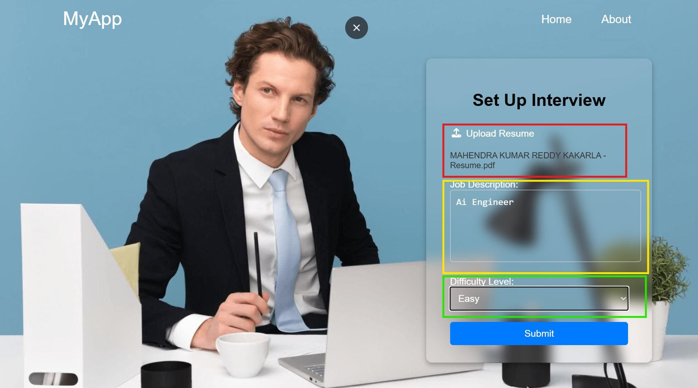
Output
14
 Frontend Home Page
Resume Uploading
Job Description
Difficulty Level
Fig. 6: Home Page Interface Screenshot

Slide 17
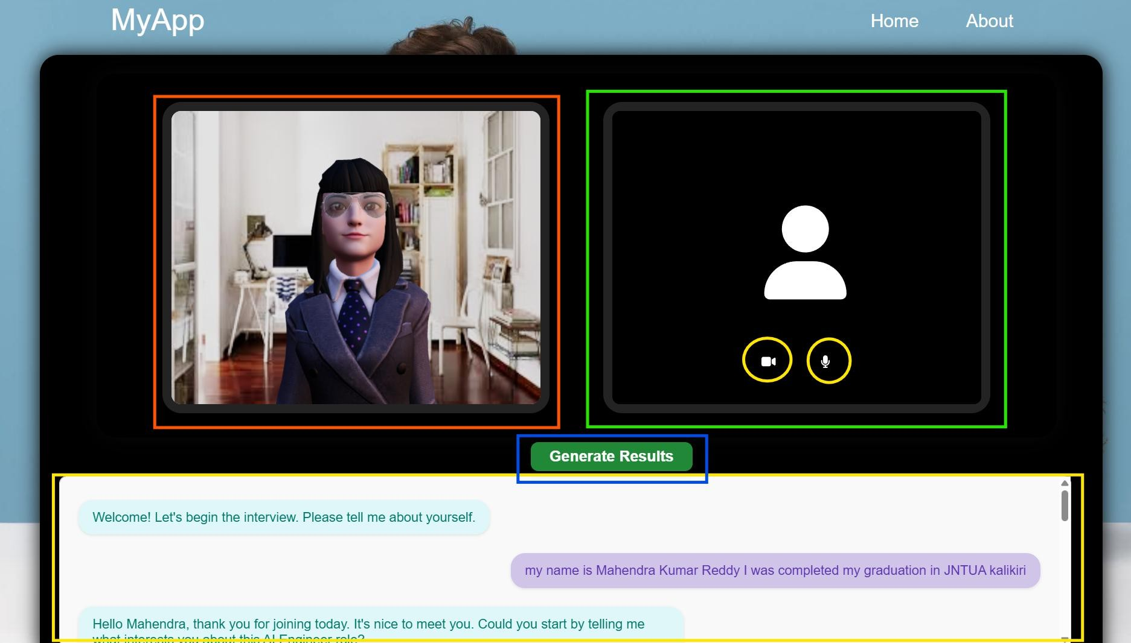
Output
15
 Interview Panel
Avatar
User Live Feed
Interview Conversation Chat
Evaluation call
Fig. 7: Interview Panel Screenshot

Slide 18
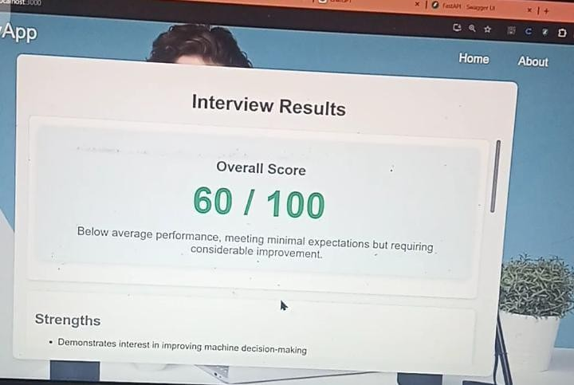
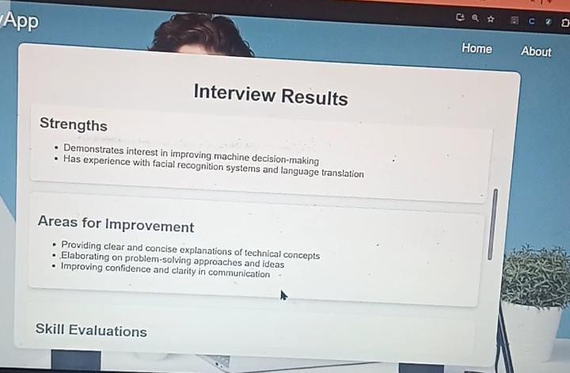
Output
16
 Evaluation Report
Fig. 4: Interview Evaluation report Screenshot

Slide 19
Conclusion
17
The AI Mock Interview System combines 3D avatars, AI-driven questions, and speech recognition to create a realistic interview experience. Using Google Web Speech API, Llama 3-70B, Edge TTS, and Mixamo animations, it enhances preparation with real-time feedback and personalized evaluation. This system improves candidate confidence and adaptability, paving the way for future AI-driven advancements in interview training.

Slide 20
Future Enhancement
18
Emotion Recognition Integration
Incorporate facial emotion analysis to assess candidate confidence, anxiety, or hesitation levels for deeper performance evaluation.
Multilingual Support
Expand to support regional and global languages, allowing users to practice
interviews in their native or target job market language.
Personalized Feedback System
Implement advanced feedback analytics using sentiment analysis and scoring mechanisms tailored to industry-specific job roles.
Mobile Application Deployment
Launch a mobile version to increase accessibility and allow candidates to practice on- the-go with the same immersive experience.
Real-Time Facial Expression Animation
Sync avatar expressions and gestures with user emotions to create an even more
human-like interaction.

Slide 21
Reference
19
 EZInterviewer: To Improve Job Interview Performance with MockInterview Generator:
arXiv:2301.00972v1 [cs.CL] 3 APR 2026
 Towards an AI-Driven Talking Avatar in Virtual Reality for Investigative Interviews of Children

Slide 22
Thank You
20

